Slide 1
Online Retail Store Analysis
By
Cornelius Enetomhe

Slide 2
Import and Cleaning
Data Import
I firstly downloaded the csv file from the provided link
Data cleaning on excel
Ensured to remove rows with missing values from the dataset
Checked for consistency in data formats e.g. datetime, decimal system etc.
Checked for duplicate rows in the dataset and also did a spelling check
Removed rows where the quantity was below 1 unit
Removed rows where the Unit price was below $0

Slide 3
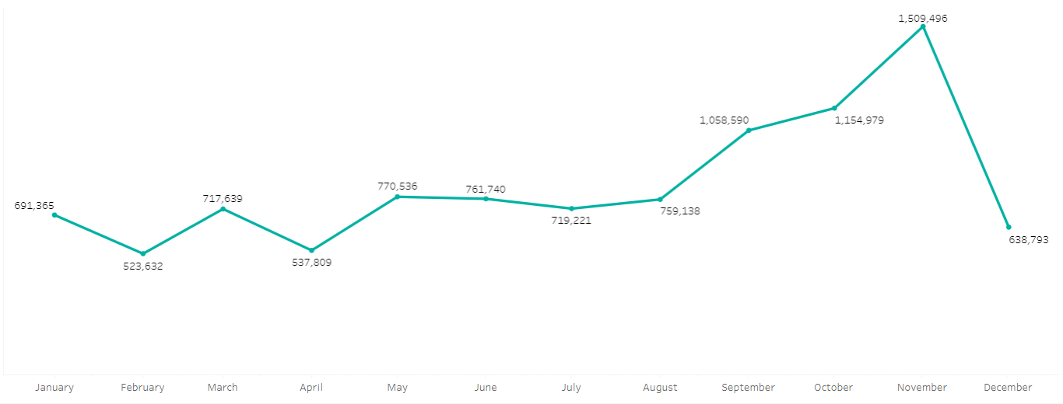
2011 Revenue
The view of a monthly series of the revenue data for the year 2011. We can diagnose seasonal trends as sales spiked between august and November

Slide 4
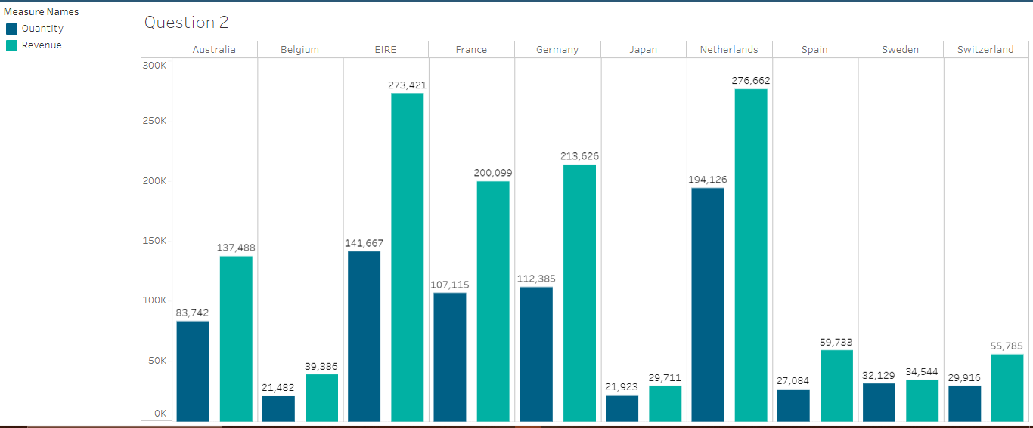
Country Revenue
I also viewed the top 10 countries which are generating the highest revenue and also the quantity sold in those countries. Giving clear view of company spread of revenue generation

Slide 5
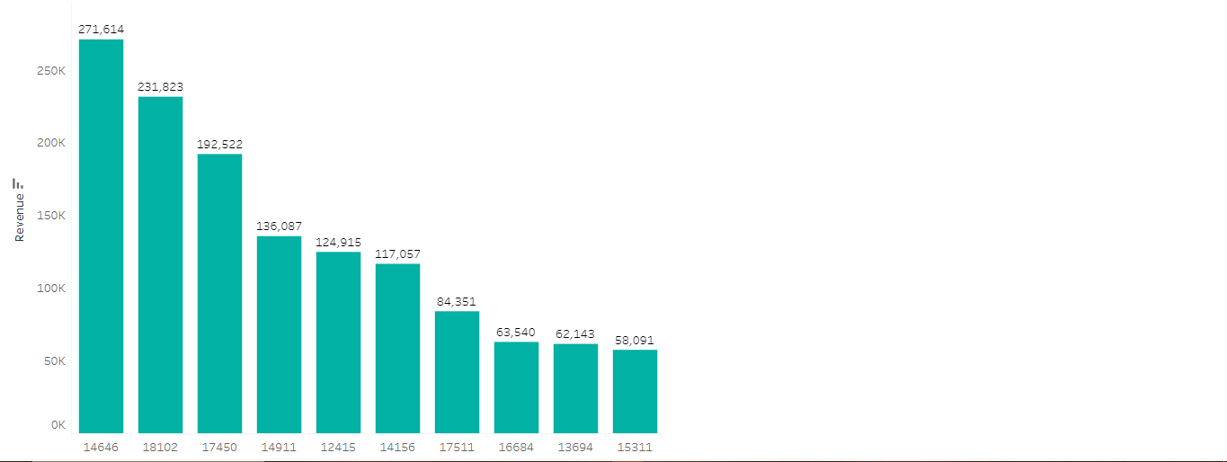
Customer Revenue
The view of the top 10 customers among store users by revenue generated.

Slide 6
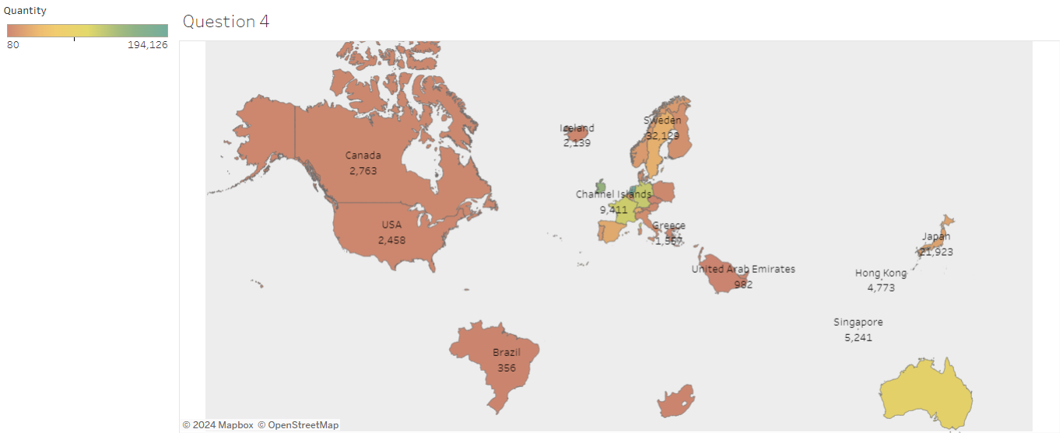
Demand per Region
I took a look at all countries and produced a chart of which regions have made the most sales asides the UK.

Slide 7
Recommendation
The company can target these region with higher demands to keep up in sales and also generate more business from other regions.
We can use this information to track and maintain customer satisfaction of our top clients with our products.
Investigate reasons behind season trends in sales

